Slide 1
Photo Based T-Shirt Size Detection
By-
Ameya Angal
Raghottam Talwai
Rohan Kasture

Slide 2
Motivation
Paradox of choices while shopping clothes online.
Selecting the appropriate cloth size is a commonly faced problem.
Sizes vary with physique, brands, gender, measurement scale(US , UK or EU) and age-group.
Choosing the wrong size may lead to inconvenience to users.

Slide 3
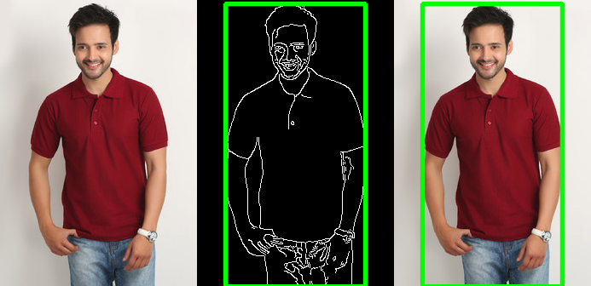
High Level Approach
Cropping the input image to fix to a square shape and applying any transformation if needed.
Applying edge detection techniques.
Finding shirt demarcation where there is a steep change in the color contrast (between white background and T Shirt in photo)
Marking key points like shoulder, neck and body.
Matching different size templates with the key points giving an approximate match.

Slide 4
Key Challenges
Images uploaded may have different perspectives and maybe some scaling and transformations would be required.
Feature extraction may get complex.
Data Collection of different brands sizes.
Generating templates based on the data.
Steep learning curve.

Slide 5
Expected Results
Our application will give the approximate T Shirt size for a uploaded image depending on gender, age group, brand and measurement scale.
We will also test this application on some real users and try to find the accuracy for our prediction.

Slide 6
Road Map
March 5th - Data Collection and Generating Templates
March 19th- Image Processing
April 3rd - UI Integration
April 15th - Evaluation , Testing and Optimizations

